Slide 1

DEPARTMENT OF COMPUTER SCIENCE AND ENGINEERING
AND
INFORMATION TECHNOLOGY
AI ASSISTED TELEMEDICINE KIOSK
SECTION : IT-B
BATCH : 4
 | Name | Roll No.
1. | PUNNA SAI GANESH | 21BK1A1298
2. | VANJARAPU BHANU CHARAN | 21BK1A12C3
3. | BELLAMKONDA RAGHU | 22BK5A1203
Dr. K. Little Flower
PROJECT GUIDE

Slide 2
SPEECH RECOGNITION SYSTEM USING GOOGLE API

Slide 3
PROBLEM STATEMENT
Most industries need speech-to-text transcription to be accurate and efficient, but the solutions developed so far are error-prone, expensive, and painstaking. Advanced tools fail with complicated speech or noise in the background. There is thus a great need for a very robust yet quite straightforward system to work by quick and accurate speech-to-text conversion while allowing flexibility about where you can store and access the transcriptions. This project is intended to provide a dual-interface solution that would have the functionality of saving text into Notepad, in addition to an option for downloading that could be saved as a PDF file. It will address all the needs of the user, personal as well as professional applications, while working on making the application accessible for users with speech impairments.

Slide 4
PROPOSED SOLUTION
The proposed system makes use of an easy to use speech-to-text tool provided by Google Cloud Speech API.
This tool gives two kinds of interfaces: the Notepad Interface, which translates speech into a Notepad file saved as `.txt` document, and the Web Interface, whereby users can download their transcription as PDF files for easier sharing and archiving.
The flexibility of the system allowed users to switch interfaces according to current needs. It provided high accuracy and reliability even in noisy environments with advanced speech recognition, audio pre-processing, and language modelling.
Designed with accessibility in mind, this system is supportive of people with speech impairments and thus fosters better cross-professional and private communication.
Combining the aspects of accurate transcription with versatile output options, it constitutes an efficient, powerful solution for vast numbers of users.

Slide 5
EXISTING SOLUTIONS VS PROPOSED SOLUTION
There are several existing systems of speech recognition that are widely used today such as Google Speech-to-Text, Microsoft Azure Speech to Text, Apple Siri etc. The Google Cloud Speech-to-Text API offers reliable and scalable speech recognition capabilities, making it suitable for a wide range of applications, including transcription services, voice assistants, call centre analytics, voice command processing, and more.
DRAWBACKS OF EXISTING SYSTEM
Accuracy Limitations
Privacy and Data Security
Language Support and Model Limitations
Customization Complexity

Slide 6
REQUIREMENTS
HARDWARE REQUIREMENTS
Processor : I3/Intel Processor
Hard Disk : 160GB
RAM : 8Gb
SOFTWARE REQUIREMENTS
Operating System : Windows 10,11
IDE : PyCharm
Libraries Used : Pynput, Pywinauto, Pyaudio, Flask
Technology : PYTHON, HTML, CSS, JAVA SCRIPT

Slide 7
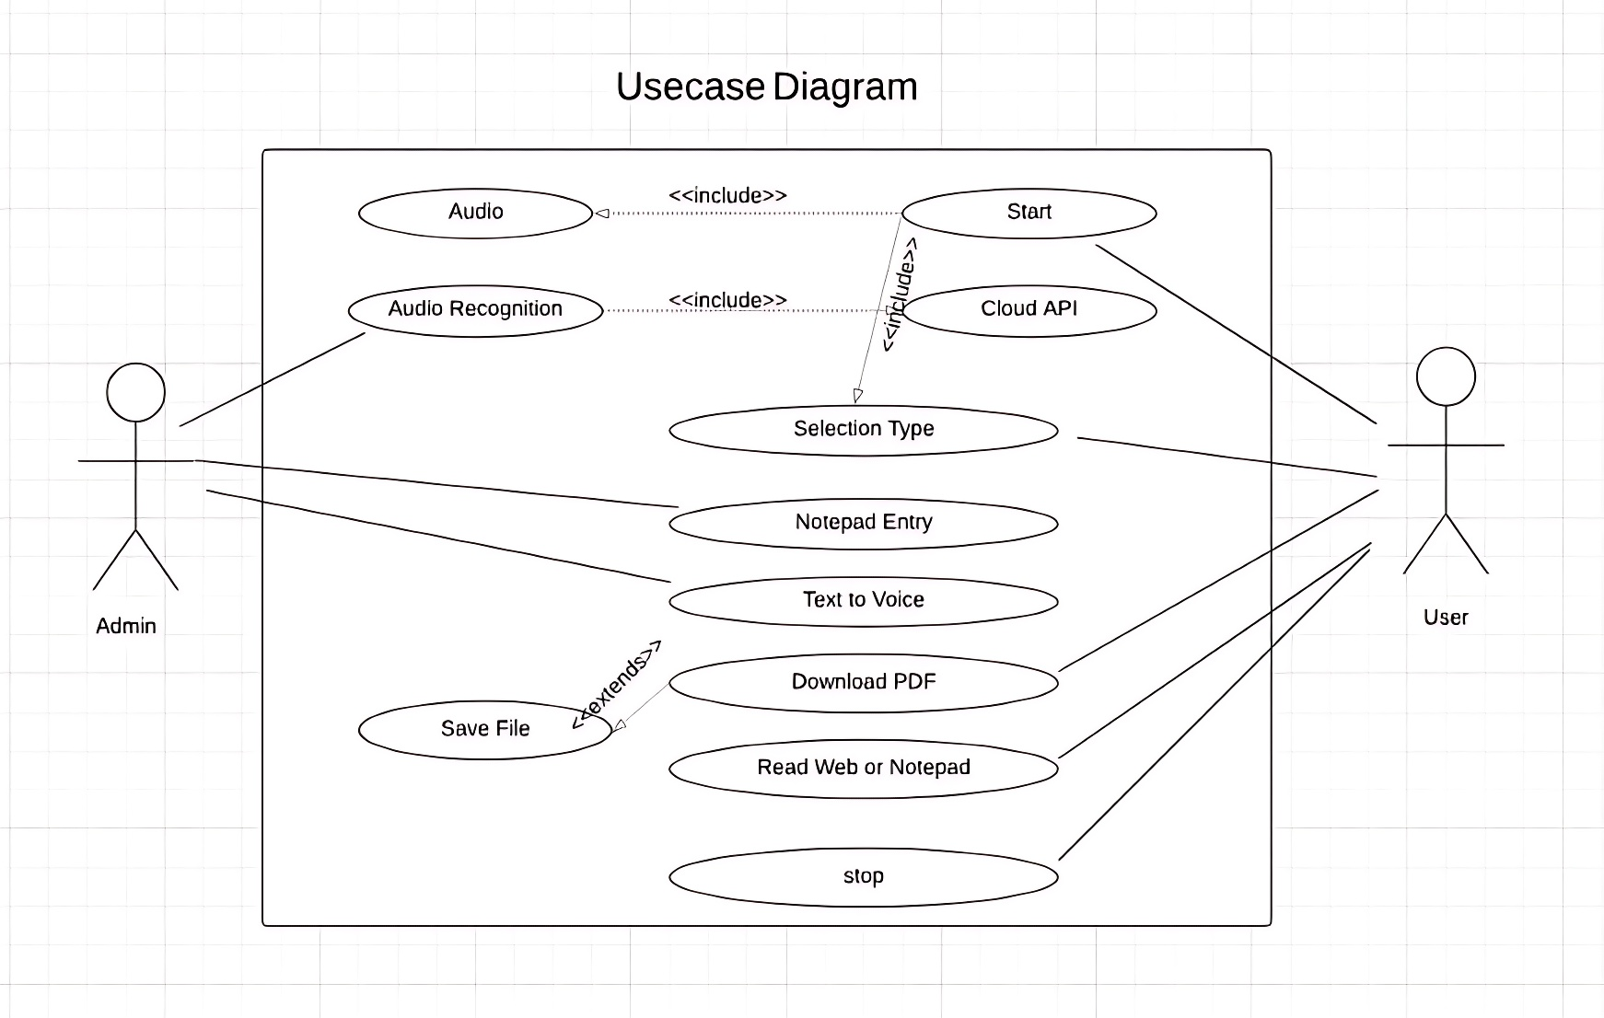
UML DIAGRAMS
USE-CASE DIAGRAM

Slide 8
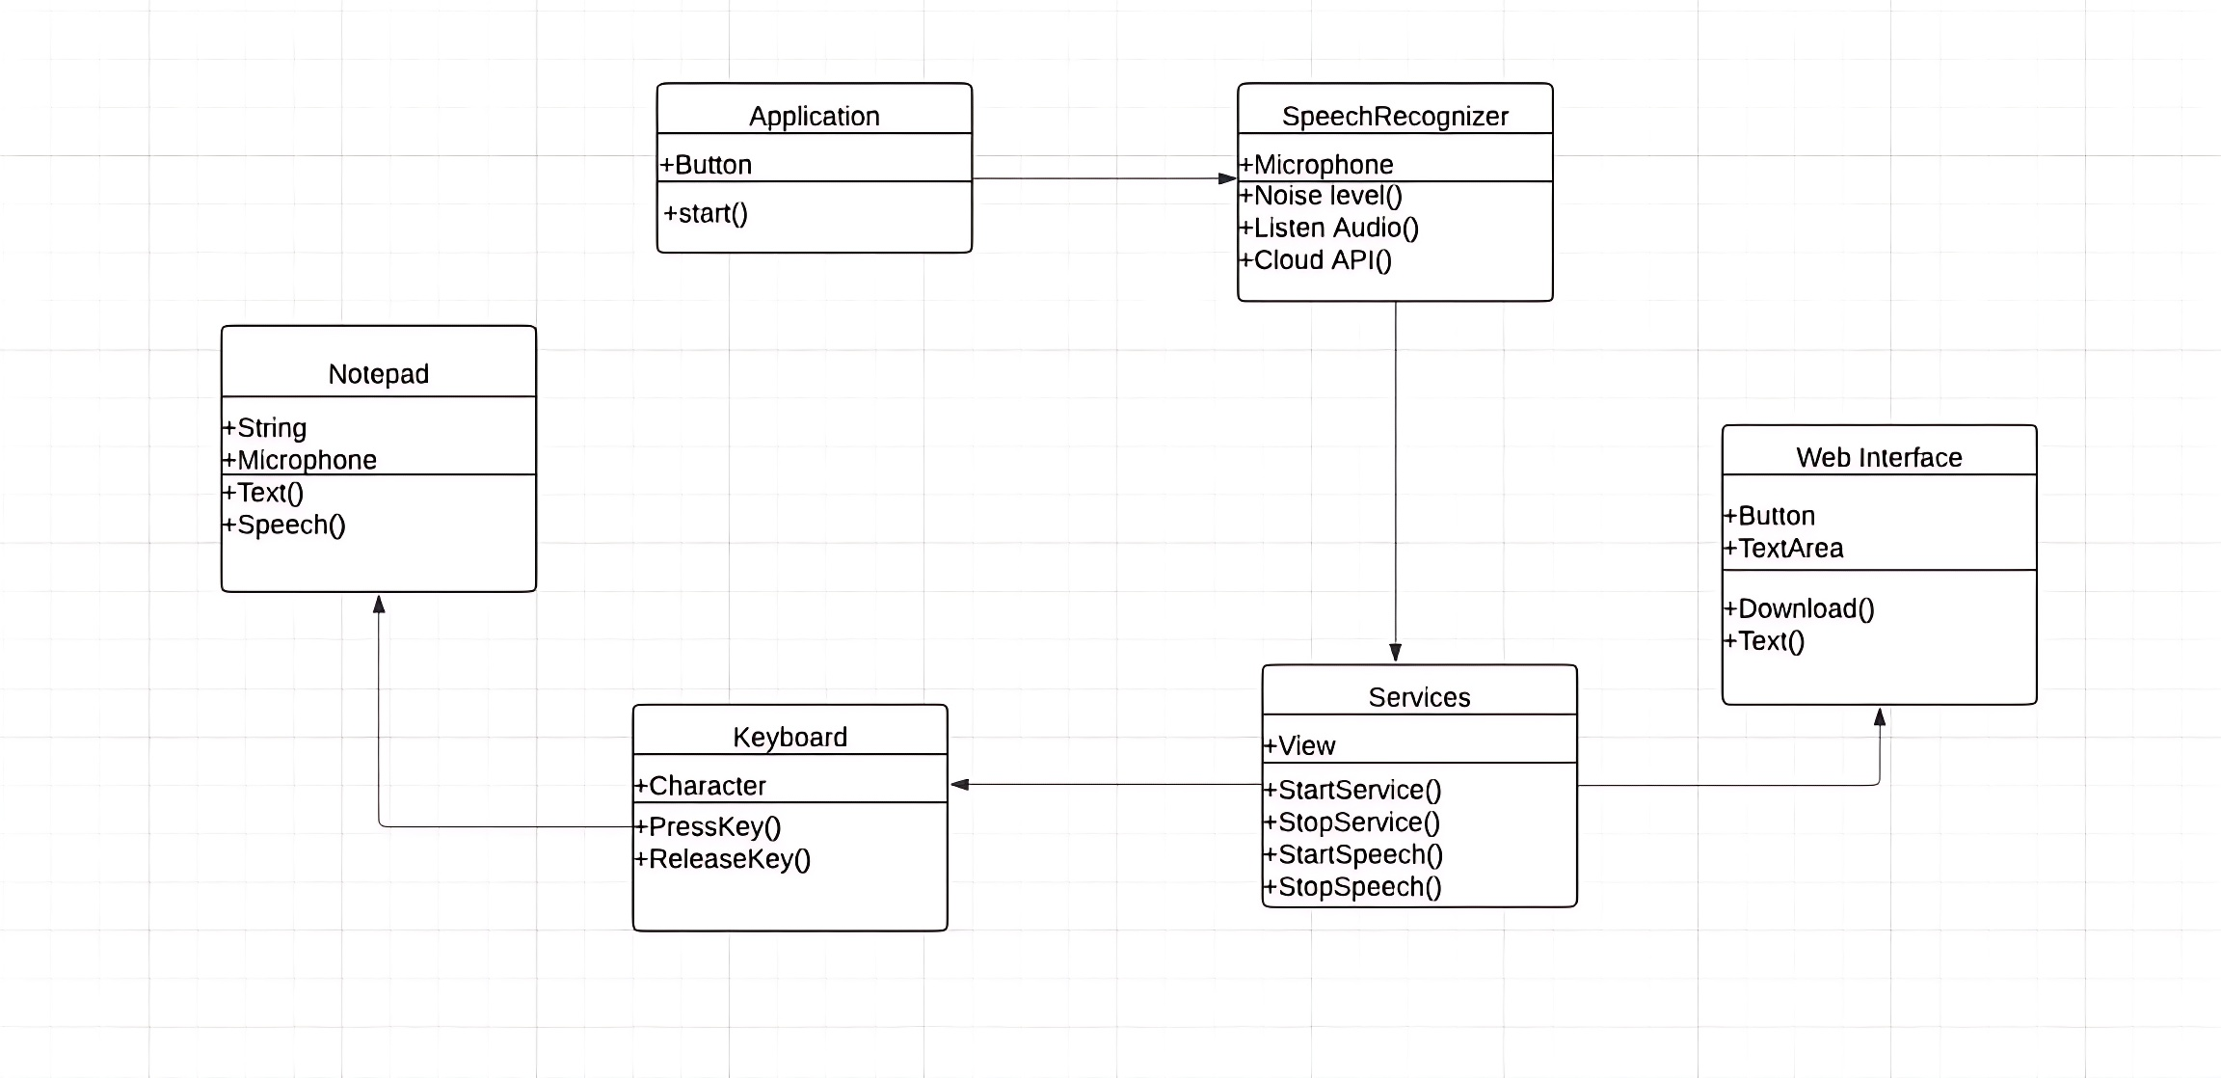
UML DIAGRAMS
CLASS DIAGRAM

Slide 9
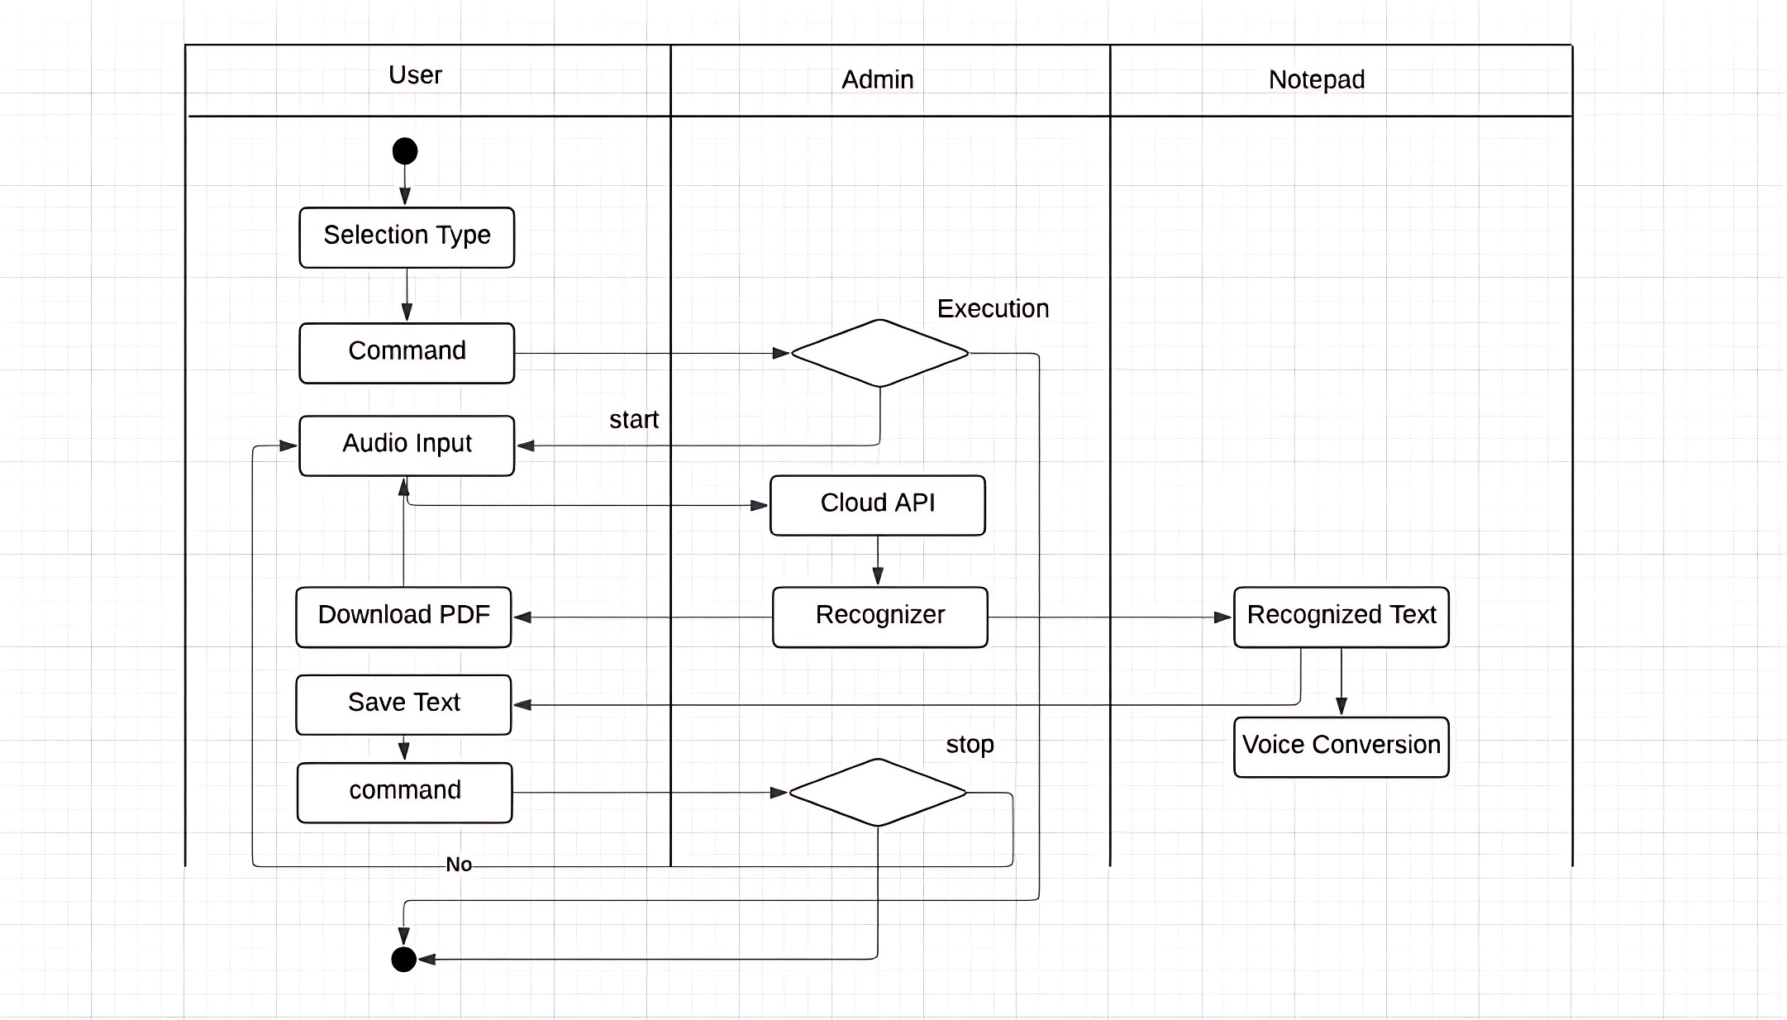
UML DIAGRAMS
ACTIVITY DIAGRAM

Slide 10
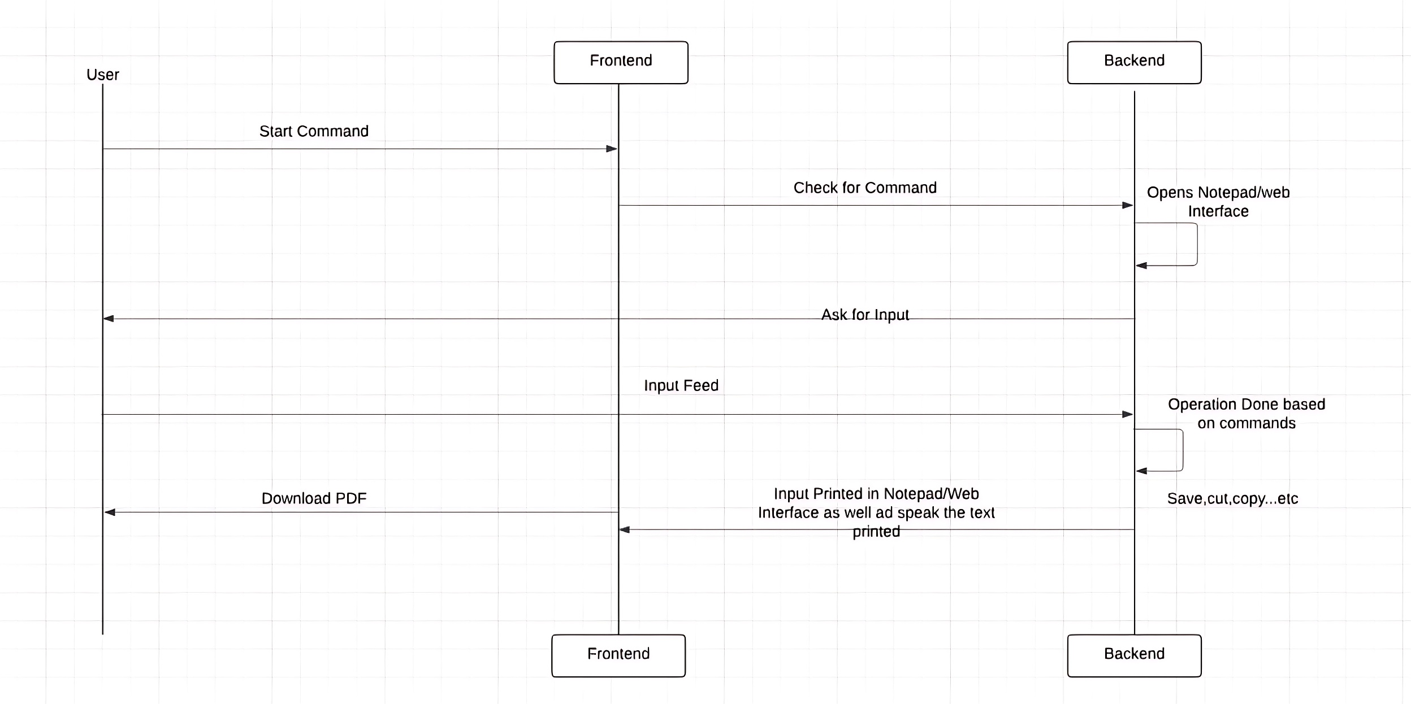
UML DIAGRAMS
SEQUENCE DIAGRAM

Slide 11
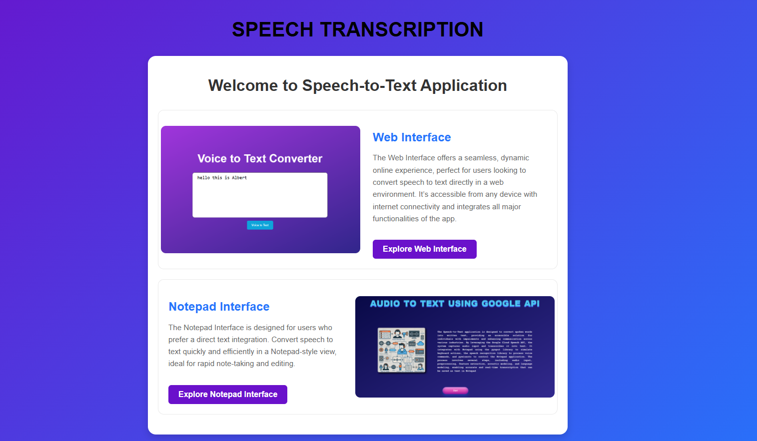
PROJECT OUTPUT

Slide 12
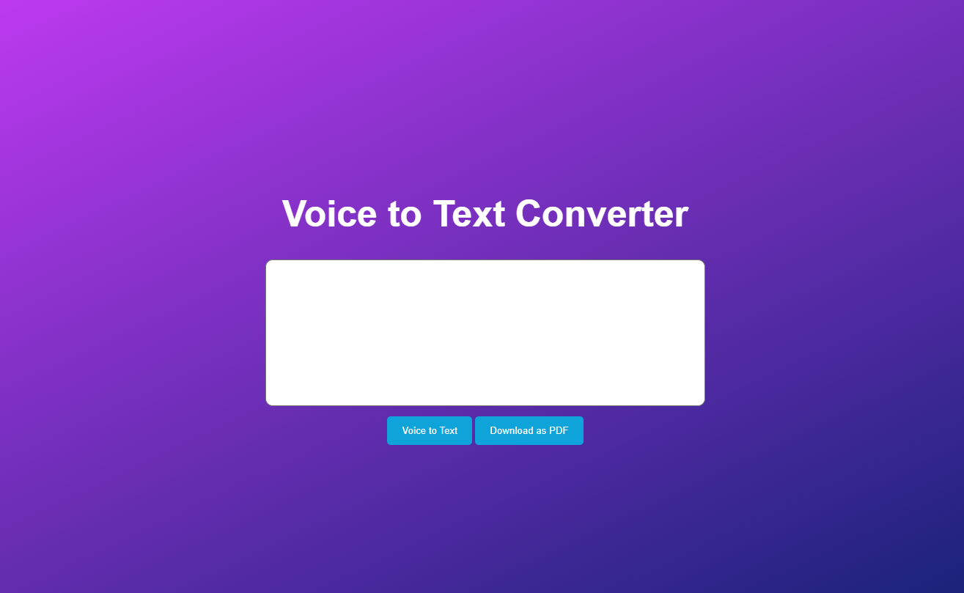

Slide 13
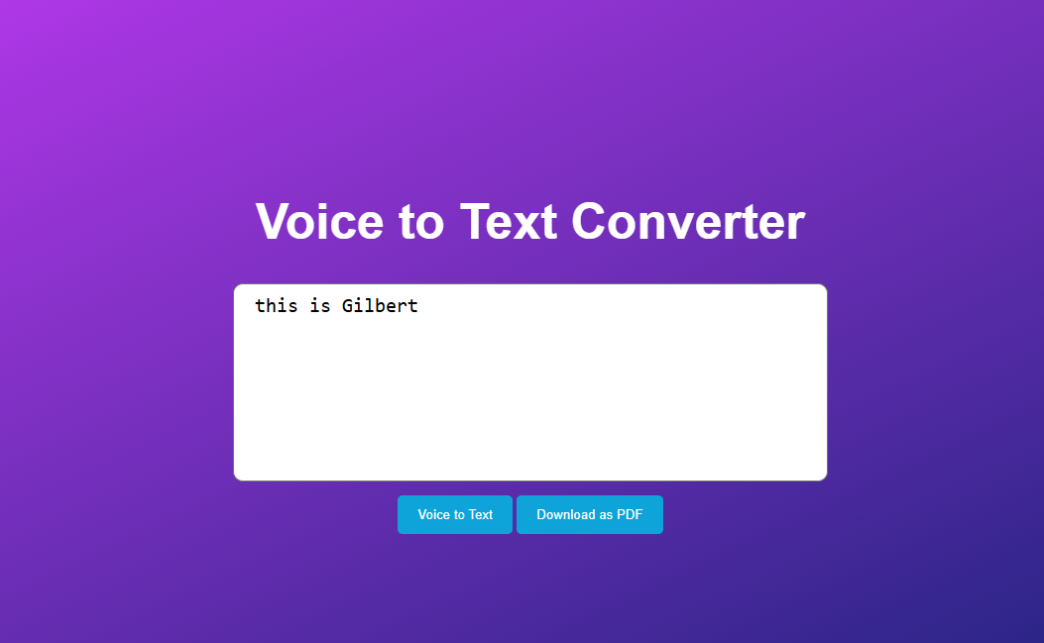

Slide 14
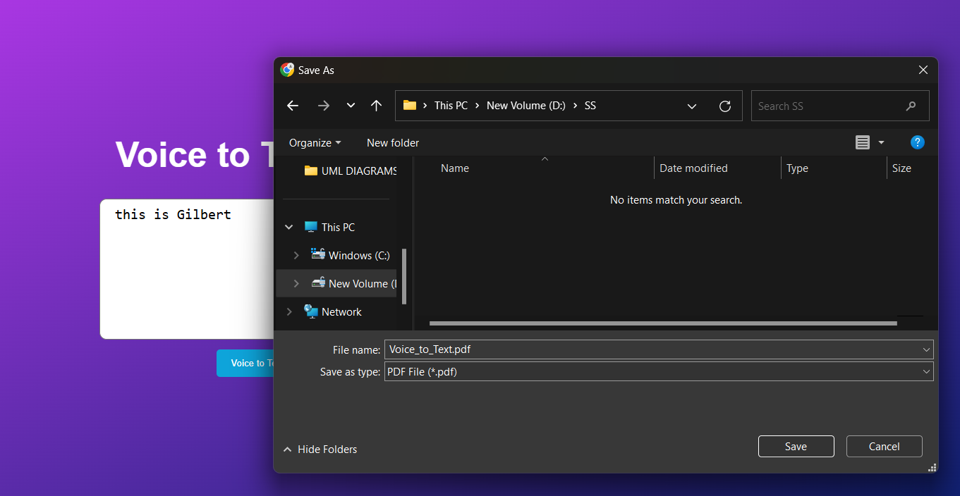

Slide 15
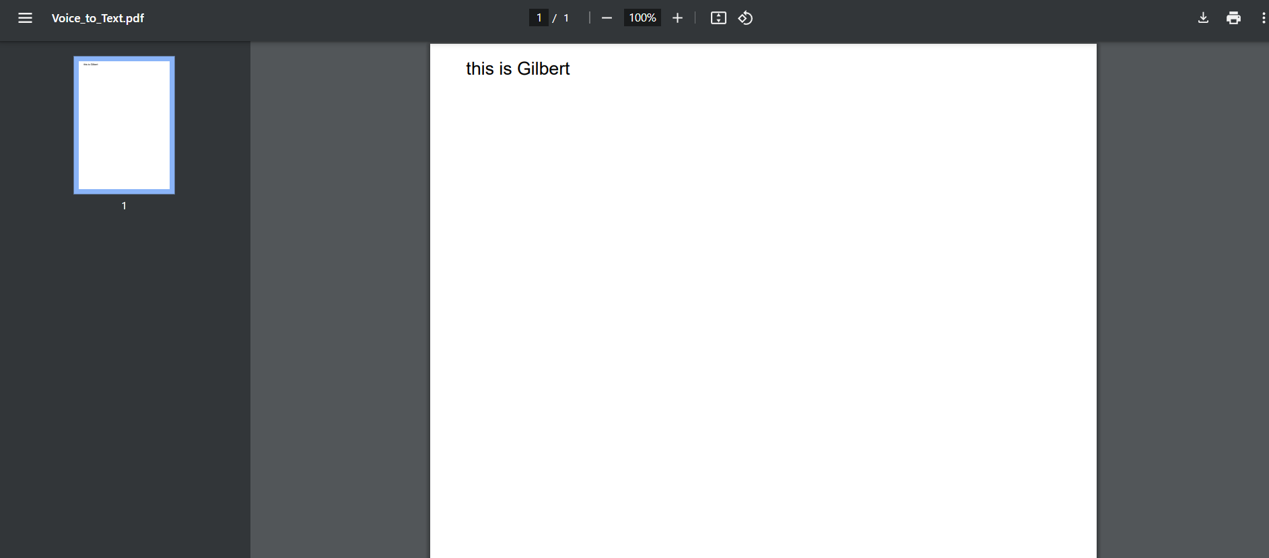

Slide 16
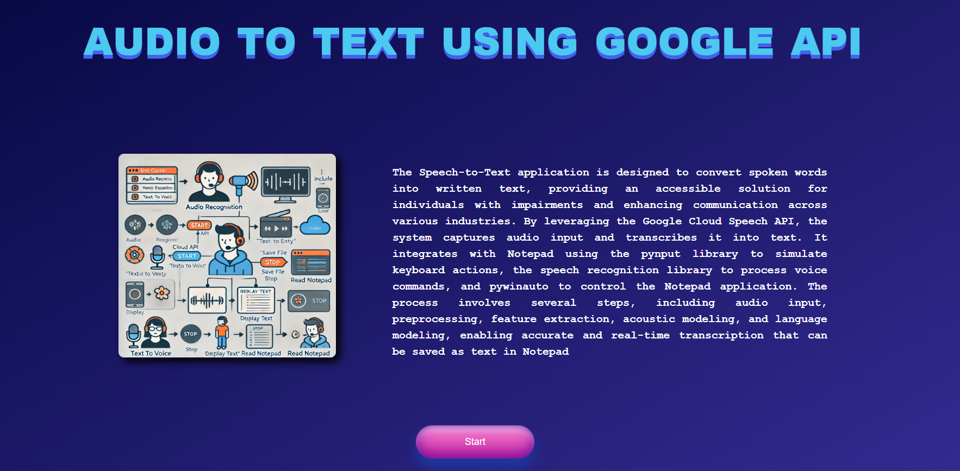

Slide 17
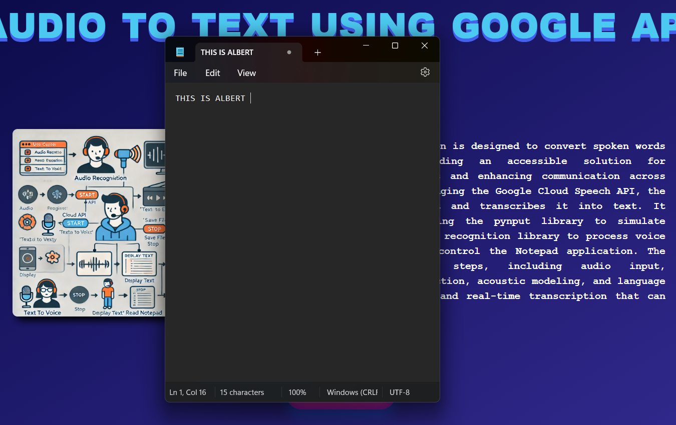

Slide 18
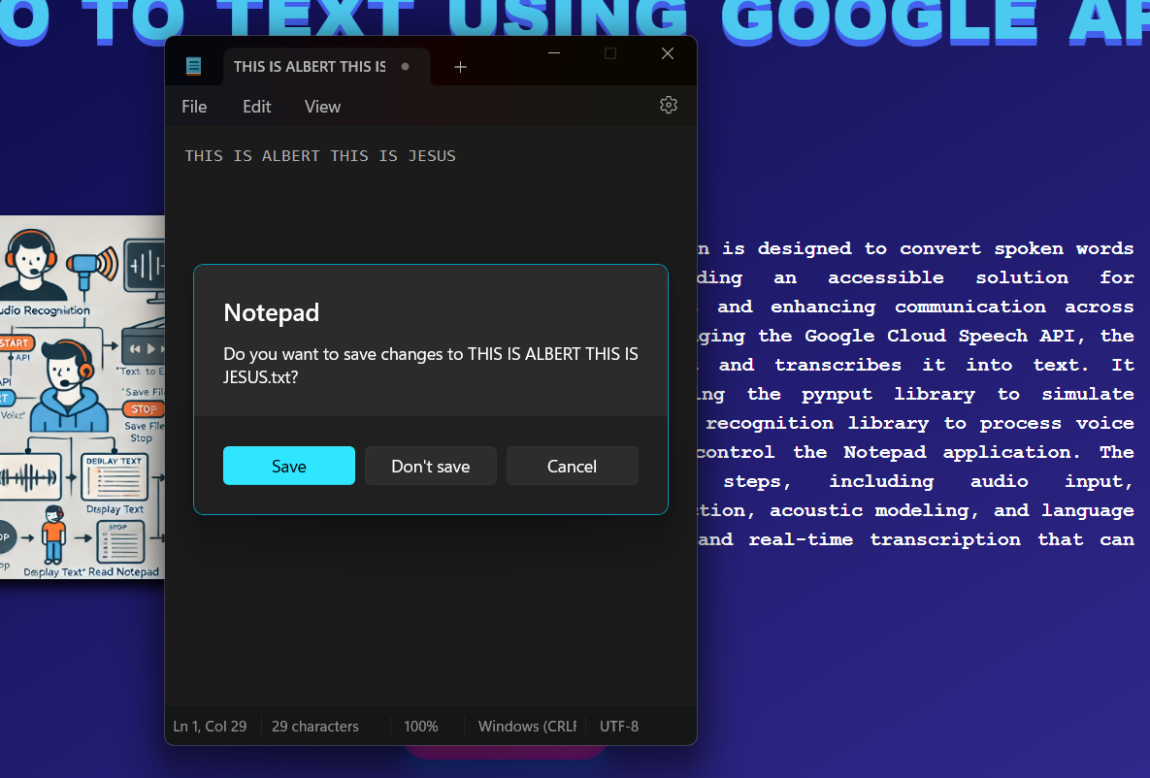

Slide 19
BENEFITS AND LIMITATIONS
Efficient note-taking and transcription tool.
Voice assistant with natural text-to-speech output.
Enhanced accessibility for individuals with speech impairments.
Accurate speech-to-text conversion for precise transcription.
Versatile applications in note-taking, voice assistance.
Seamless text-to-speech conversion for natural-sounding audio output.

Slide 20
CONCLUSION
The Google Cloud Speech API facilitates the speech recognition system through Notepad and Web interfaces. It employs high innovations such as HMM and Deep Learning to ensure perfect performance in all noisy environments as well as accommodate users with any form of speech impediment. Use of libraries such as Pynput and Pywinauto enhances the user experience of navigating applications on both the desktop and the web in a fluid and natural way. Further advancements could include the addition of language support, which will allow real-time transcription, include voice command functionality to enable hands-free control, noise-cancellation feature refinement for better accuracy in noisy conditions, mobile platforms integration, and cloud storage integration for the easy access and viewing of files from any device. Personalization of user customizations should be incorporated to fine-tune speech recognition while ensuring enhanced encryption and secure communication for improved data security.
.
PROJECT GUIDE : Dr. K. LITTLE FLOWER

Slide 21
THANK YOU

